Slide 1

Research program:
Innovative 3D Reconstruction
in Civil Infrastructure
Group 14: Yingxue Zhang
11/04/2024
Notes:
In this day and age, almost all people are immersed in digital technologies even if they are unaware of it. When a new technology is developed, one of the most important subjects is data privacy and security. When it comes to 3D reconstruction, this subject is also very important.

Slide 2
Data Privacy and Security in 3D Reconstruction
Group 14: Yingxue Zhang
11/04/2024
Notes:
In this day and age, almost all people are immersed in digital technologies even if they are unaware of it. When a new technology is developed, one of the most important subjects is data privacy and security. When it comes to 3D reconstruction, this subject is also very important.

Slide 3
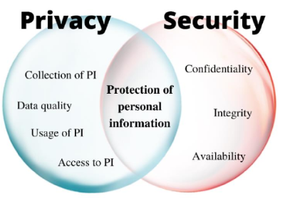
Concept of Data Privacy and Security
protecting data against unauthorized access, use or destruction by implementing appropriate technical controls, mechanisms and procedures
the proper handling, processing, storage, and usage of Personal Information
Notes:
First of all, let’s talk about the concepts of data privacy and data security.
Data privacy revolves around …
Data security is focused on ... Data security involves everything from the physical security of the storage devices and hardware to administrative access controls and the security of software applications.
Data security is a prerequisite for data privacy.

Slide 4


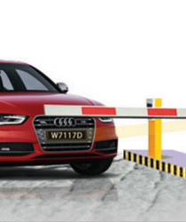
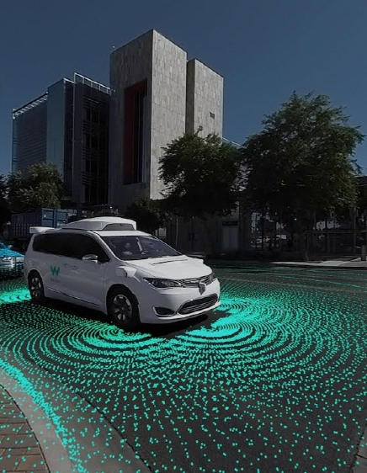

Data Privacy of 3D Reconstruction
The data collected may unintentionally or unavoidably contain sensitive information:
Faces
License plate numbers
Private property
……
Notes:
Then what are there in data privacy of 3D reconstruction?
In the first step of 3D reconstruction, we need to gather some 2D images or Scan the target object. This data …. If not handled properly, such information could pose a serious threat to individual privacy, such as personal identity leakage.

Slide 5
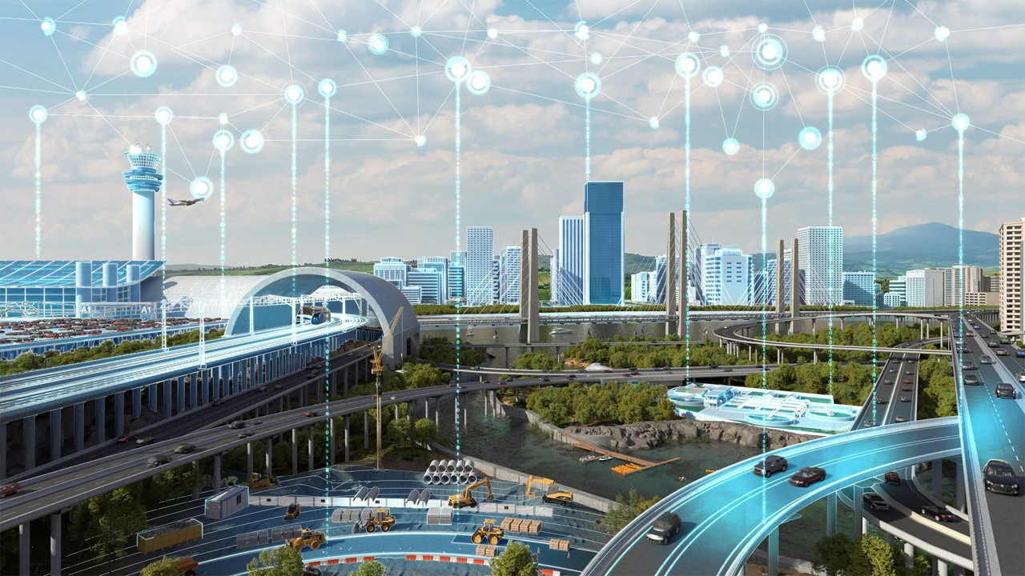
Data Privacy of 3D Reconstruction
For my research:
01
All data is legally obtained from public data.
Ensure that the obtained data does not contain sensitive or personal information. If so, such information will be manually blocked.
02
Confirm that the data use license permits the research to be done and that any output complies with copyright and usage conditions.
03
Notes:
For my research…

Slide 6

Data Security of 3D Reconstruction
Safety hazards may include:
2D/3D data loss, leakage or tampering
Encounter unauthorized access (such as malicious attacks)
Service interruption (service unavailable)
Legal and compliance risks (such as breaches of GDPR - EU’s General Data Protection Regulation)
……
Notes:
What about data security of 3D reconstruction? Data safety hazards……

Slide 7


Data Security of 3D Reconstruction
For my research:
01
Regular data backup (backup to the R drive of Curtin University if possible)
Implement access control policies (only authorized users can access research data)
Perform version control on the code so that the previous version can be quickly activated after discovering problems that cannot be solved
Follow ethical principles, laws and regulations
02
03
04
Notes:
For my research…

Slide 8

Conclusion
Notes:
In conclusion, as 3D reconstruction technology advances and is applied across various fields, data privacy and security become issues we cannot ignore. It is the cornerstone of ensuring the healthy development of 3D reconstruction techniques.

Slide 9

THANK YOU

